Slide 1
WICCI – HPWC (Haryana Psychological Wellbeing Council)
WOMEN´S INDIAN CHAMBER OF COMMERCE AND INDUSTRY
www.wicci.in

Slide 2
Haryana Psychological Wellbeing Council’s Vision & Mission
Vision:
To inspire and motivate council sisters to create a healthy psychological life for themselves, those around them, and improve society’s understanding of mental health, emotional wellness, and psychological well-being.
Mission:
To spread awareness and teach various psychological techniques to people such that they can use this knowledge to improve their own emotional & psychological well-being and thus have a positive sense of self and self-esteem, and enhance the enjoyment of life!

Slide 3
Welcoming
Council Members to
WICCI
President, Vice President
and 20+ Nominated Council Members

Slide 4
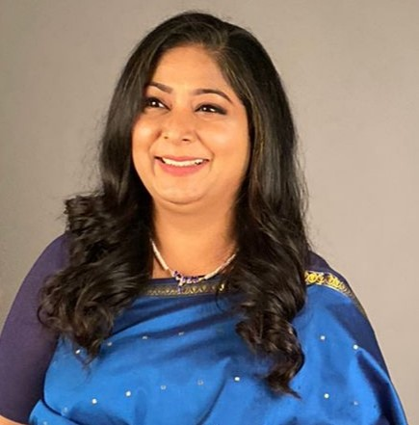
Kavita Yadav
PRESIDENT WICCI – HPWC (Haryana Psychological Wellbeing Council)
BIO:
Ms. Kavita is a Counseling Psychologist & Psychotherapist, Certified Parenting Coach, Children & Adolescent Mental Health Expert, Career Guidance & Counseling Expert, EFT practitioner, EI coach, Marital & Family Therapist, and Author, working with parents, tweens, teens, and adults with more than 18+ years of experience.
She supports, guides, and counsels parents in their parenting challenges and works with young adults and adults in the area of mental health, emotional wellness, psychological well-being, and making the right career choices with her group and one-to-one counseling sessions.
She is also the Founder, Director of her center called JiNa.LivingPositively

Slide 5
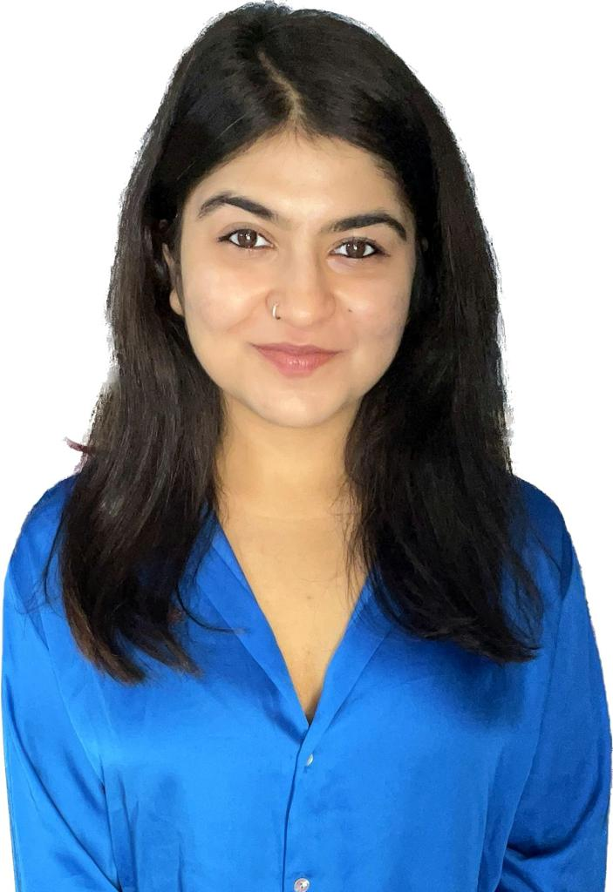
Himadri Sharma
VICE PRESIDENT WICCI – HPWC (Haryana Psychological Wellbeing Council)
BIO:
Ms. Himadri is a counselling psychologist, a life skills coach, a listening facilitator, a social worker, and sometimes a content writer. She does her bit to promote mental health by taking workshops, and live sessions and promoting a safe space for everyone, its importance and everything that can be done to achieve a society that is mentally, and emotionally fit.
Therapy is for everyone and is not only a luxury for a few, with this thought she has dedicated 4 years of her life to provide a safe space in Counselling individuals and their families. She adopts the person-centric approach and is a CBT, and Gestalt practitioner.

Slide 6
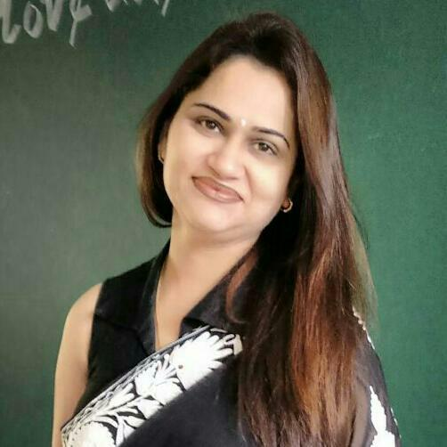
Abha Grover
COUNCIL MEMBER WICCI – HPWC (Haryana Psychological Wellbeing Council)
BIO:
Ms. Abha is a Psychologist who is currently pursuing her Ph.D. (Psychology). She has also done BSc ,BEd , and MA Education.
At present she is working as a PRT with DPS Sec 45 Gurgaon. She has 15+ years of experience and has also done diploma in Kathak dance.
She has had a wonderful life till now full of responsibilities, hard work, dedication, love, care in professional and personal areas both. She would now like to give back to society with the same love, care, compassion, and dedication.

Slide 7
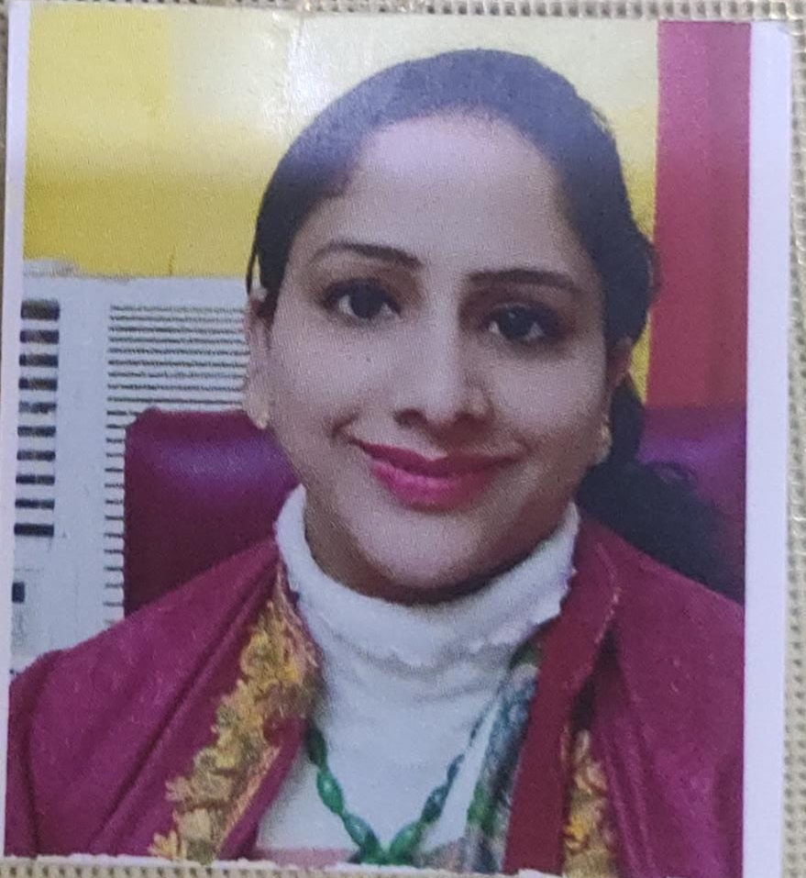
Anju Sangwan Gadhwal
COUNCIL MEMBER WICCI – HPWC (Haryana Psychological Wellbeing Council)
BIO:
Mrs. Anju Sangwan Gadhwal is a psychologist, psychotherapist and a counselor.
She has done her postgraduation in clinical psychology, counseling psychology and Applied psychology. She has also done her B.Ed in inclusive education and her diploma in special education. She is currently persuing Ph.D in psychology.
At present she is working as a freelance counsellor n psychologist (especially for children n marriage counseling).

Slide 8
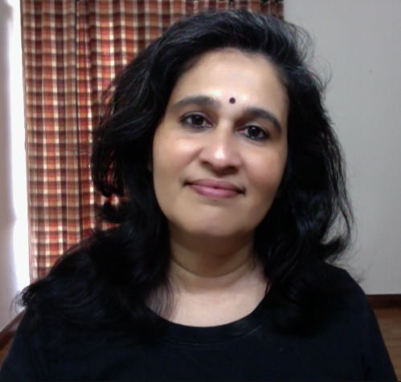
Anupama Anand
COUNCIL MEMBER WICCI – HPWC (Haryana Psychological Wellbeing Council)
BIO:
Ms. Anupama has done her M.Sc. In Applied Psychology. She is a Counseling psychologist, parenting coach, and assessment and growth counsellor, and founder of Mindsight.

Slide 9
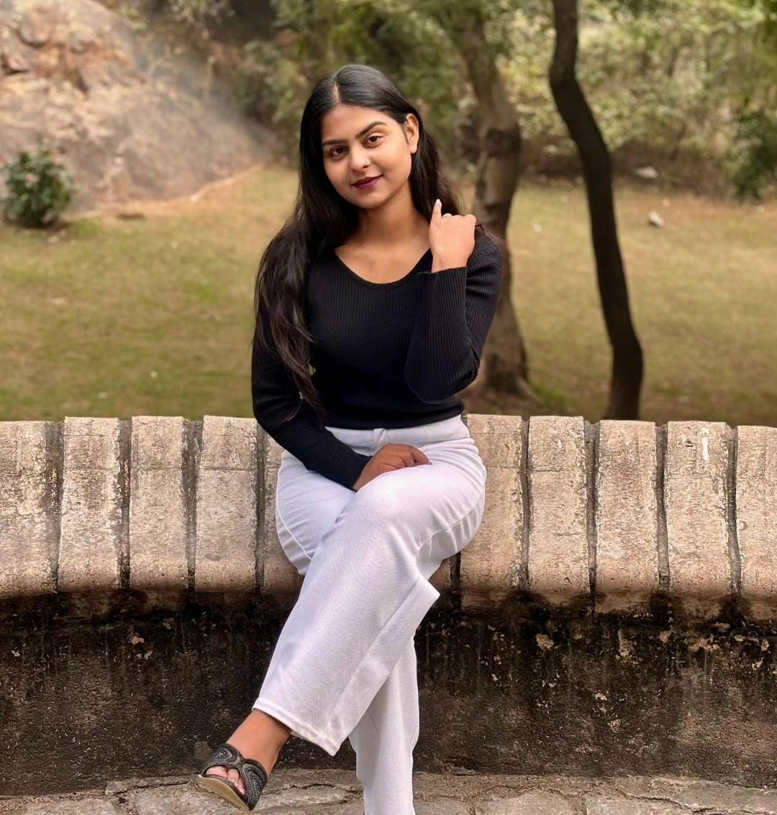
Aparna
COUNCIL MEMBER WICCI – HPWC (Haryana Psychological Wellbeing Council)
BIO:
Ms. Aparna has done her M.Sc. in Clinical Psychology and is currently pursuing RCI Advance Diploma in Child Guidance and Counselling (ADCGC) from Central University of Haryana.
She is a dedicated and empathetic psychologist with a passion for helping individuals overcome challenges and achieve personal growth.

Slide 10
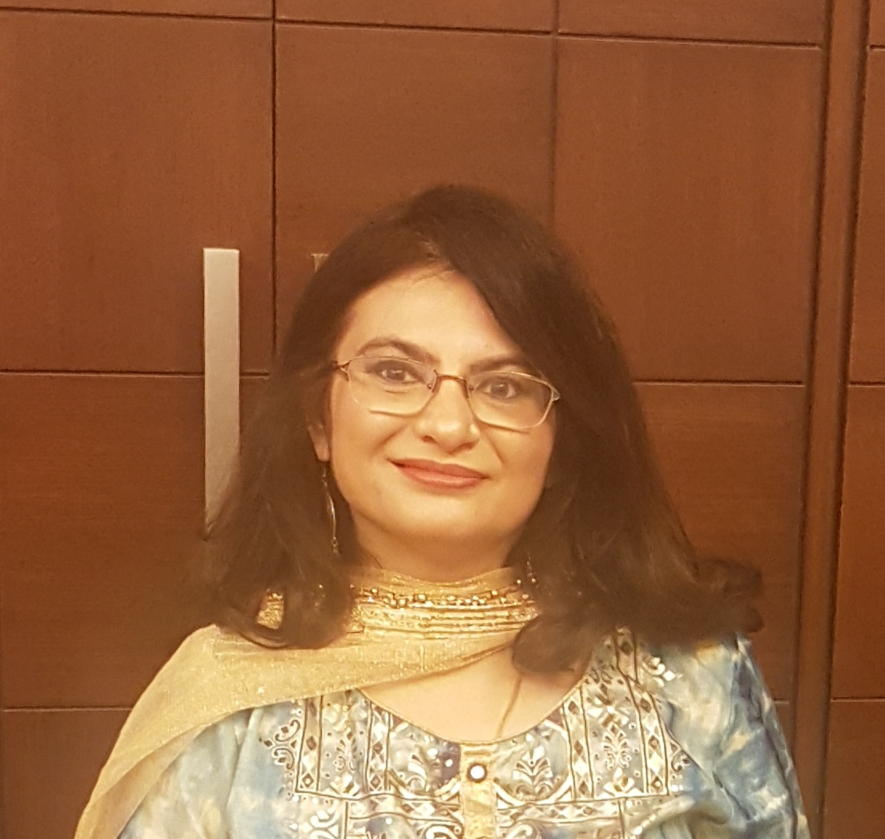
Arti Anand
COUNCIL MEMBER WICCI – HPWC (Haryana Psychological Wellbeing Council)
BIO:
Dr. Arti is a Consultant Clinical Psychologist at Sir Ganga Ram Hospital, Delhi. She has more than 25 years of experience in the field of mental health.
She specializes in Cognitive Behaviour Therapy (CBT) and is trained in individual psychotherapy and psychometric testing for adults and children.
She is a member of the Delhi Psychiatric Society.

Slide 11
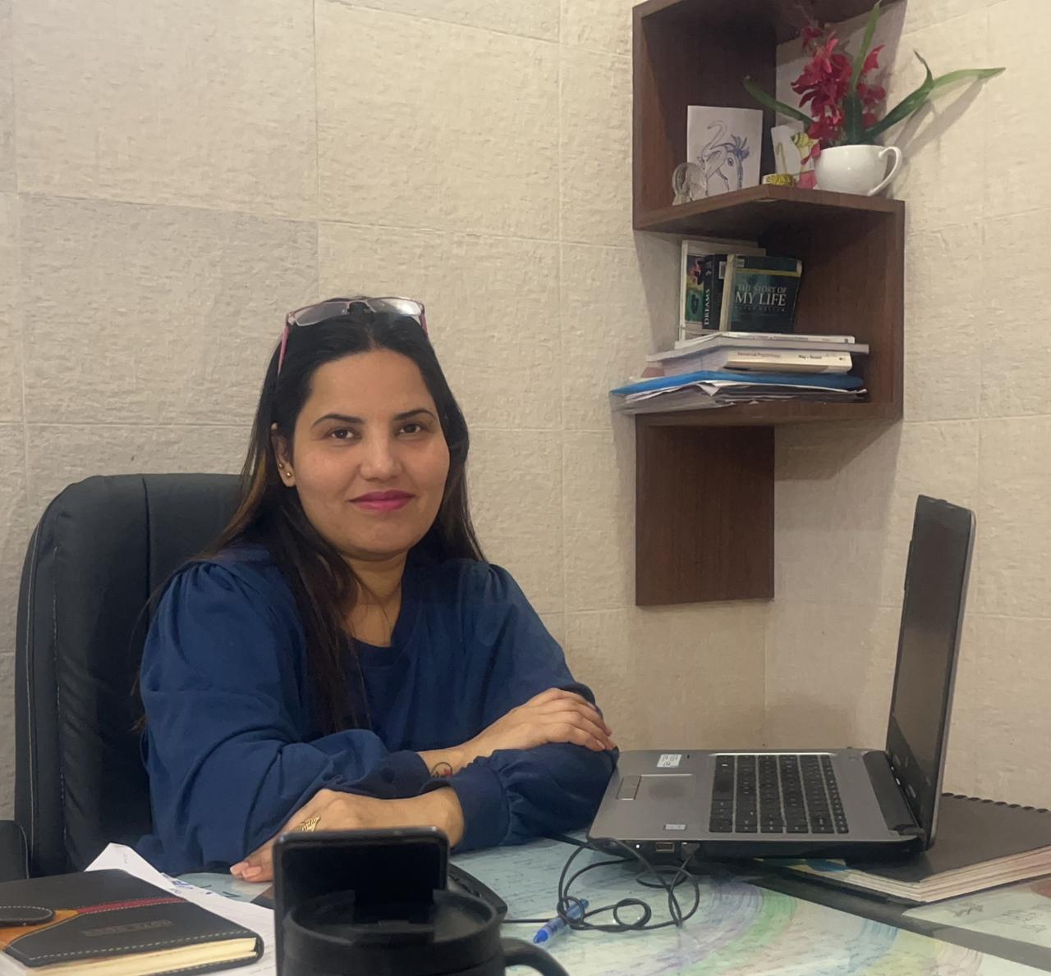
Dr. Pratibha Swami
COUNCIL MEMBER WICCI – HPWC (Haryana Psychological Wellbeing Council)
BIO:
Dr. Pratibha is a Clinical Psychologist and has also done her BAMS (Bachelor of Ayurvedic Medicine and Surgery).
She is currently working as a Psychologist at Global Hospital, Hisar (Haryana).
She has around 5 years of experience working in the field of mental health and psychological well-being. She is registered under RCI.

Slide 12
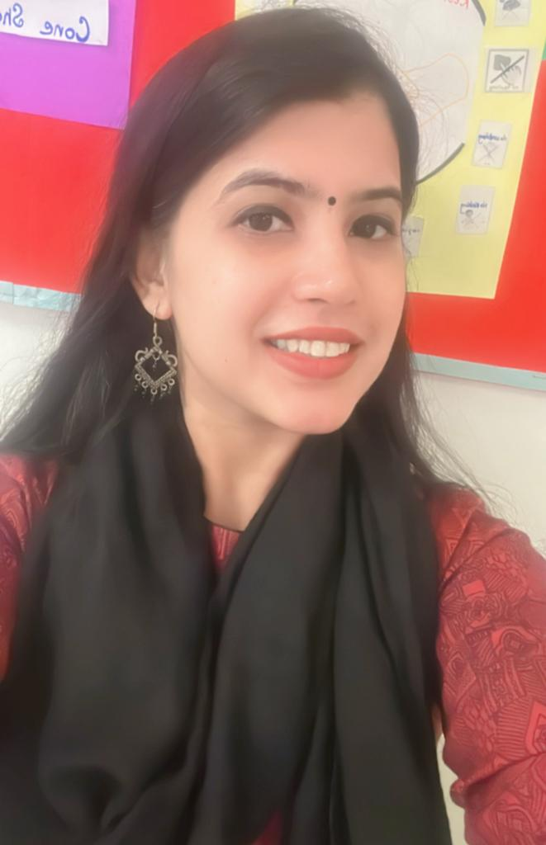
Gargi Dagar
COUNCIL MEMBER WICCI – HPWC (Haryana Psychological Wellbeing Council)
BIO:
Ms. Gargi is a Counseling Psychologist. She has also done her PG Diploma in guidance and counseling. She is passionate about making conversations around Mental Health normal! Currently, she is working with Vega Schools, Gurugram.

Slide 13
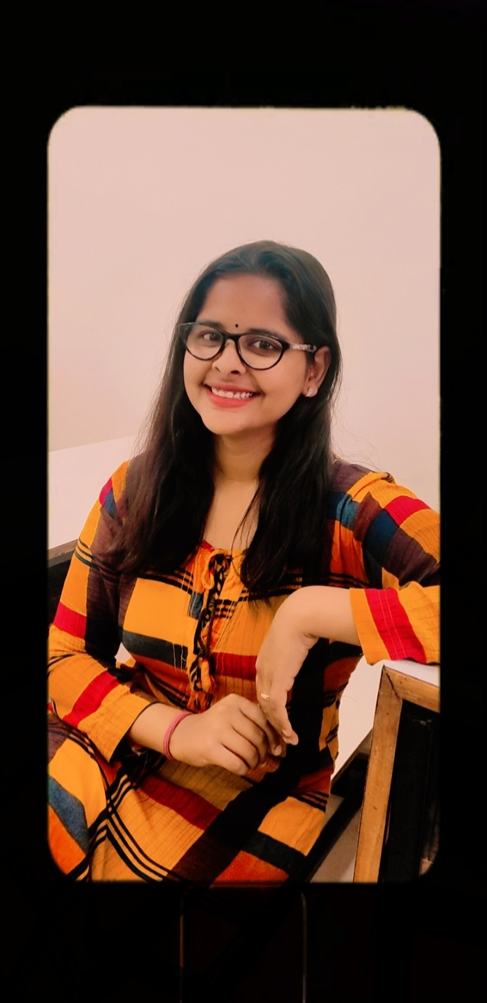
Himanshi Sharma
COUNCIL MEMBER WICCI – HPWC (Haryana Psychological Wellbeing Council)
BIO:
Ms. Himanshi has done her Master's degree in Clinical Psychology and is now pursuing an MPhil entrance as well. She has gained knowledge from various esteemed places such as Civil Hospital sec -10, Medanta - The medicity, Fortis, and many more. She holds a great knowledge of disorders, and testing assessments which she has learned from these places. She opted for psychology subject as her career because she loves to interact with people to understand their behaviour, what are causes of their reactions and what are their perceptions. She also likes to interact with people from different cultures, and backgrounds.

Slide 14
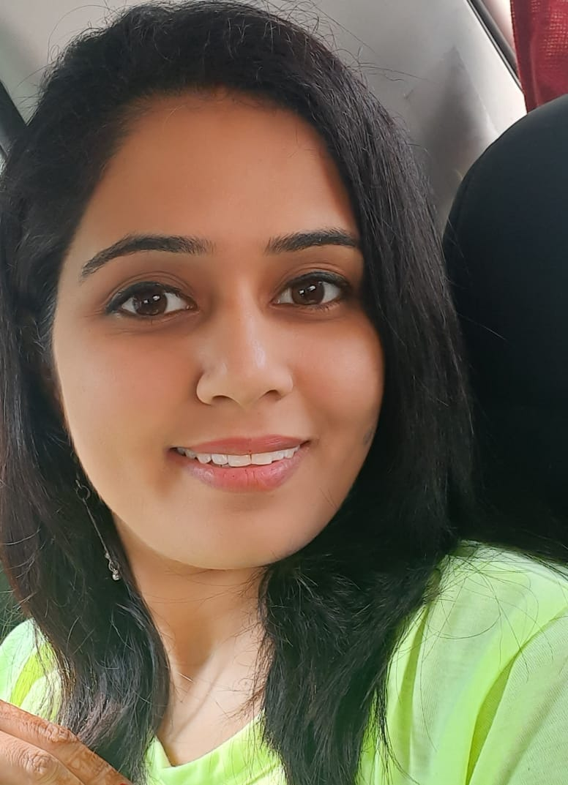
Kavita Sharma
COUNCIL MEMBER WICCI – HPWC (Haryana Psychological Wellbeing Council)
BIO:
Ms. Kavita Sharma is a Psychologist with 2 years of working experience as a PGT Psychology in a school in Gurugram.
She has also done her PG diploma in Guidance & Counselling, with an internship done in Psychiatric Department at Civil Hospital, Gurugram.
She is a self-motivated and disciplined soul. Always keen to upskill her self by learning new things.
Her strengths are her communication and human touch in any situation.

Slide 15
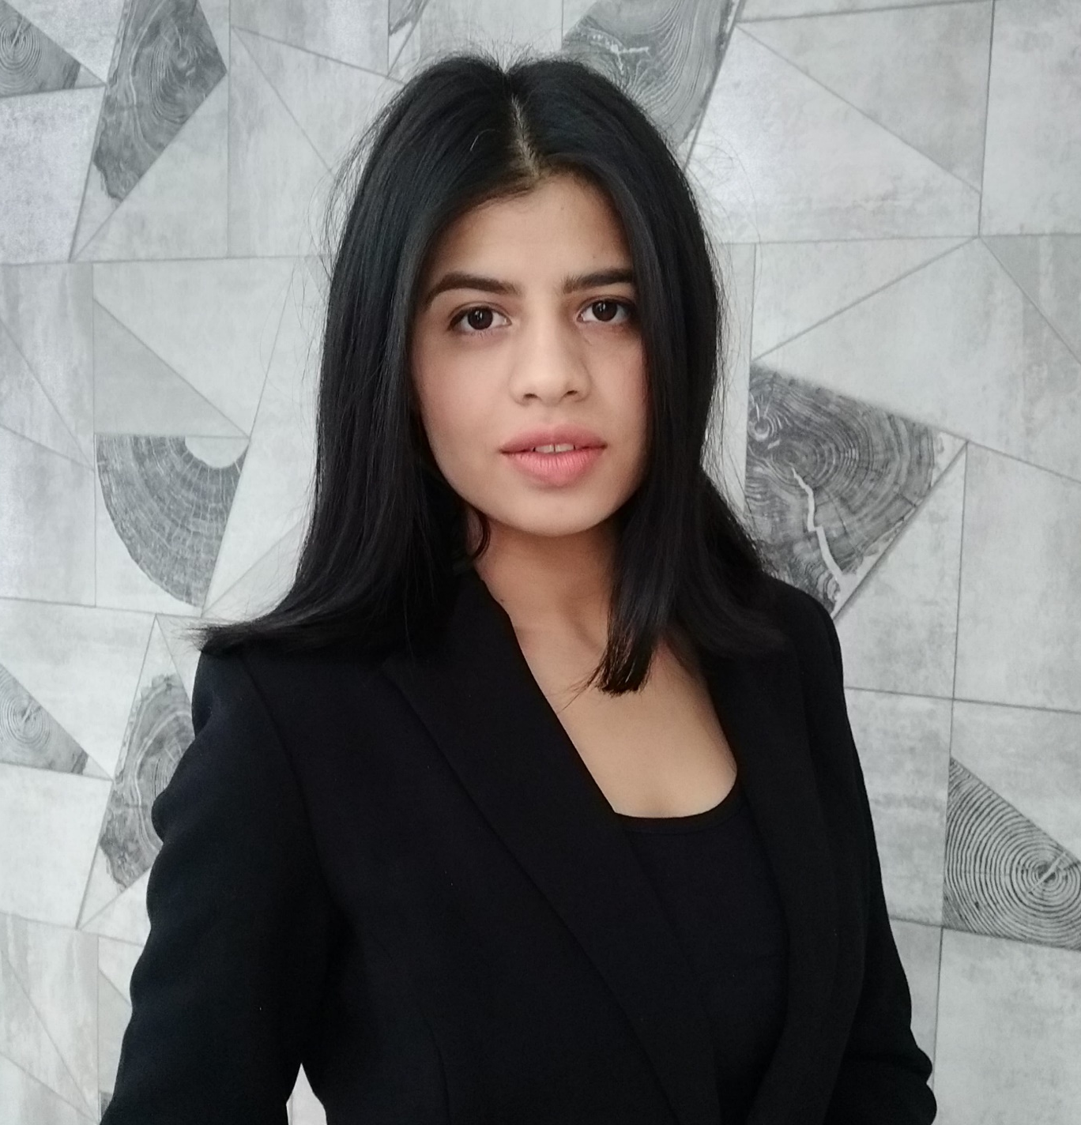
Komal Ghodarop
COUNCIL MEMBER WICCI – HPWC (Haryana Psychological Wellbeing Council)
BIO:
Ms. Komal is a psychologist and ABA Therapist. She is currently working with valorkids.
She is a mindful and compassionate professional who is committed to working with adults and adolescents and aims to acquire more knowledge in the field of Psychology.

Slide 16
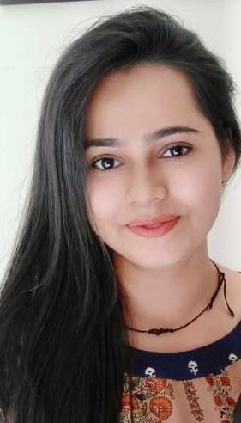
Komal Pahuja
COUNCIL MEMBER WICCI – HPWC (Haryana Psychological Wellbeing Council)
BIO:
Ms. Komal is a master's graduate in Clinical Psychology, certified dynamic counselling therapist, and current diploma student in guidance and counselling at Jamia Millia Islamia. She is particularly interested in using her skills to help individuals with anxiety, depression, and grief. Her dedication to understanding the human behaviour drives her to wake up during the Brahma muhurta for meditation. She believes in the importance of tailor-made distressing toolkits for individuals. Ms. Komal is committed to her professional development, recognizing the importance of continuous learning and growth.

Slide 17
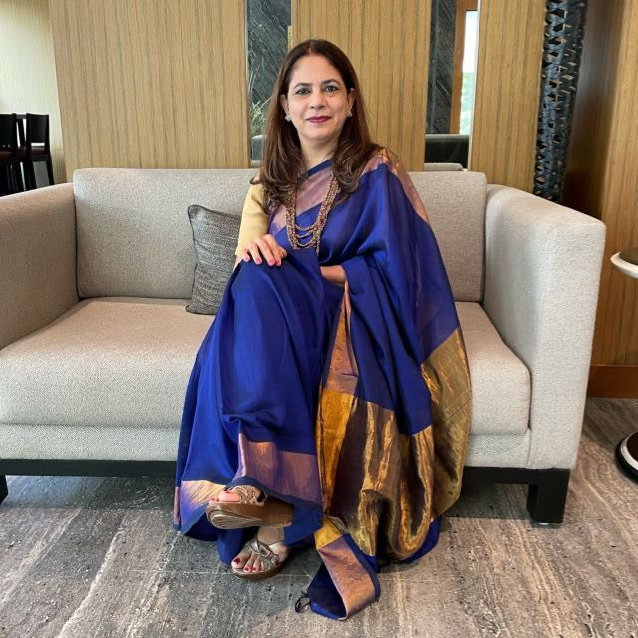
Meenu Arora
COUNCIL MEMBER WICCI – HPWC (Haryana Psychological Wellbeing Council)
BIO:
Ms. Meenu Arora is a counseling psychologist and life skill trainer having experience of more than 25 years in dealing with students, parents and teachers. Presently, she is working as Associate Director Outreach in Krea University.
She has received “Life Empowerment Award -2018” from Centre for Educational Development and “Innovation in Guidance and Counselling-2018” from ASEAP. She is a trained counselor from NCERT and has done Masters in Education, Masters in Psychology, and Diploma in Training and Development.
She has done numerous sessions for students on topics like Liberal Arts, Interwoven Learning, Examination Anxiety, stress management, Career Planning etc. along with a Professional Development Program for educators.

Slide 18
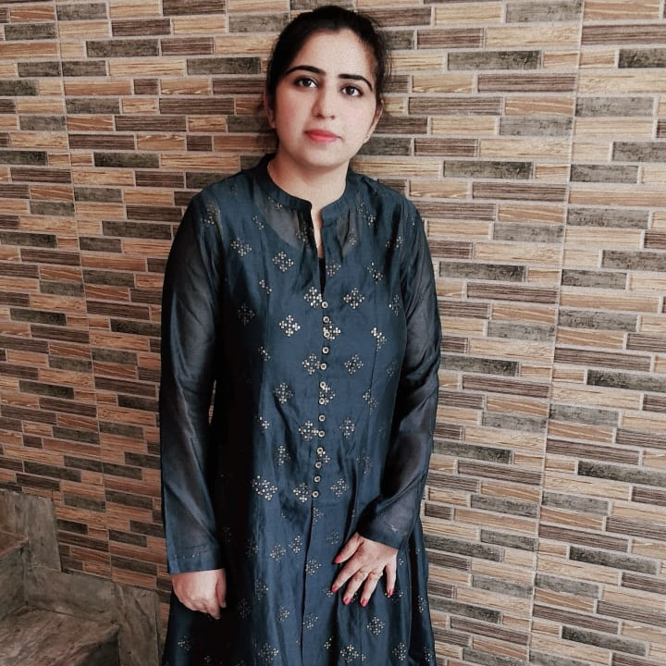
Preeti Yadav
COUNCIL MEMBER WICCI – HPWC (Haryana Psychological Wellbeing Council)
BIO:
Ms. Preeti Yadav is a Counseling Psychologist and has completed her master's degree from IGNOU in psychology.
Along with her degree, she has also cleared her CTET and HTET exams. She has 4 years of experience in teaching and is currently working as an Academic Counselor in a Public School in Gurugram.
She loves challenges as they help her to enhance & become a better version of herself every day, and always tries to share those experiences with others so as to help them in their lives as well.

Slide 19
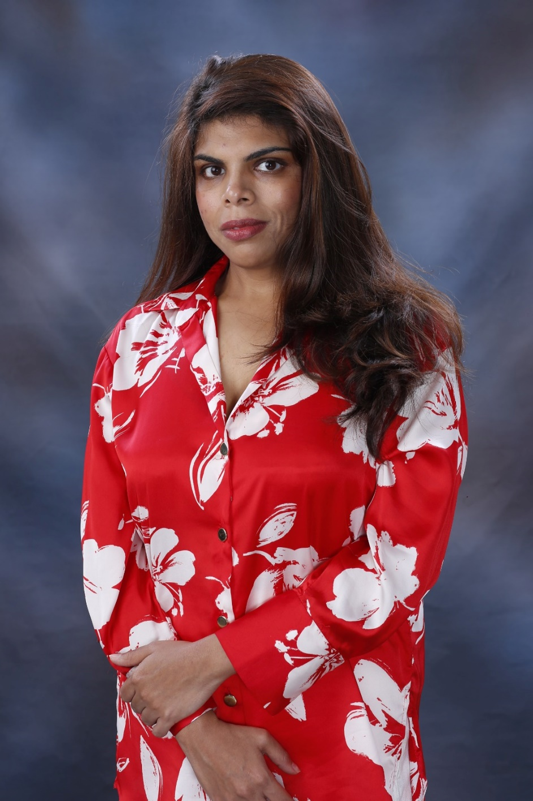
Priyanshi Jain
COUNCIL MEMBER WICCI – HPWC (Haryana Psychological Wellbeing Council)
BIO:
Ms. Priyanshi Jain is a Counselling Psychologist and is keen on working with children, and women and empowering them to take life's challenges into their hands and work on self-transformation thereby leading a happy and valuable life.
She has done her graduation in Psychology from Daulat Ram College, Delhi University, and her masters in Psychology in psychosocial clinical studies from Ambedkar University.

Slide 20
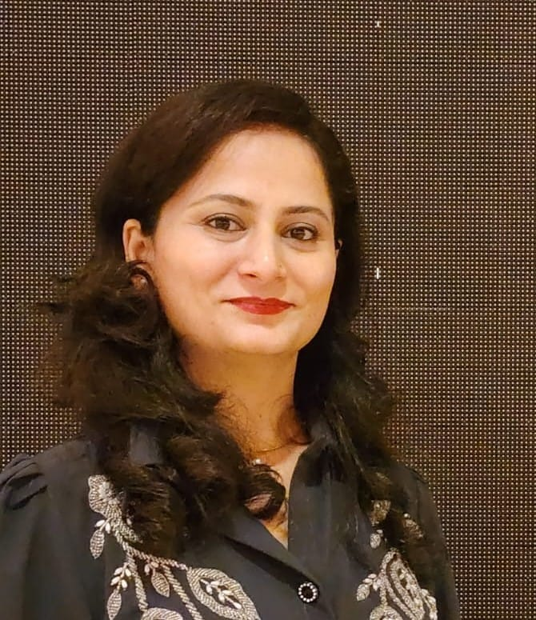
Richi Salgotra
COUNCIL MEMBER WICCI – HPWC (Haryana Psychological Wellbeing Council)
BIO:
Ms. Richi is a Counselling Psychologist (M.A in Psychology), Parenting Expert, Rehabilitation Psychologist( PGDRP, RCI affiliated course), Psychotherapist, and Founder of "Walk&Talk with Richisalgotra". She has a total of 3 years experience and is currently working with VISIT HEALTH PVT LTD as tele- Counselling Psychologist. She has also gained experience by working at CIVIL and CITIZEN HOSPITAL, GURGAON.

Slide 21
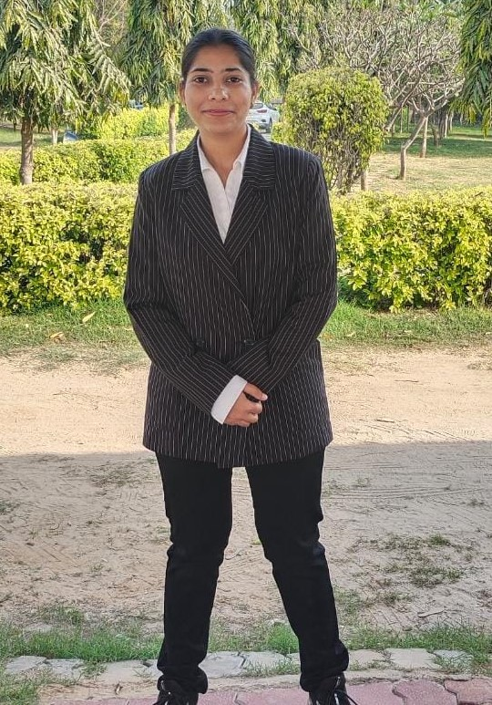
Riya Batra
COUNCIL MEMBER WICCI – HPWC (Haryana Psychological Wellbeing Council)
BIO:
Ms. Riya Batra is a Counseling Psychologist. Currently, she is pursuing Advance Diploma in Child Guidance and Counselling (ADCGC), RCI approved from Central University of Haryana, Mahendragarh.
She has completed her master’s in Psychology from Panjab University, Chandigarh. Throughout her academic and professional career, she has developed a strong passion for working in the area of mental health and Psychological well-being.
She was engaged in a special learning school where she observed and participated in therapy sessions of children with special needs. Apart from this, she was a part of the Samarthan Project with the Mental Health Foundation of India where she worked as a counselor and provided psychological support to Tihar inmates.

Slide 22
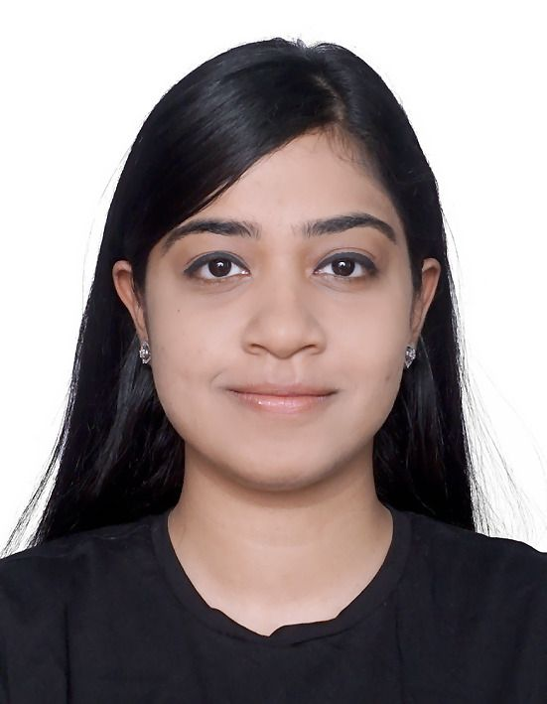
Shreya Gandhi
COUNCIL MEMBER WICCI – HPWC (Haryana Psychological Wellbeing Council)
BIO:
Ms. Shreya holds a Masters in Clinical Psychology along with a UGC NET certification. She has been working with a premier school in North West Delhi as the Head School Counsellor. She has experience of working with anxiety, depression, self-confidence issues, sleep-related issues, and relationship issues over a span of 4+ years.
She is also a trainer and has conducted workshops for parents and teachers. She believes in the inherent strength of people to become experts in their own lives. She uses an eclectic approach to therapy.
In her free time, she enjoys travelling, reading, and baking.

Slide 23
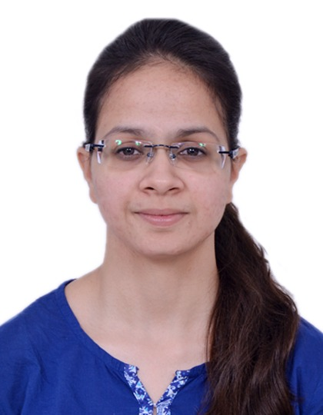
Shubham Gupta
COUNCIL MEMBER WICCI – HPWC (Haryana Psychological Wellbeing Council)
BIO:
Ms. Shubham is a Counselling Psychologist. She is also a Neuro-Linguistic Practitioner. She is a member of the National Positive Psychology Association. Shubham has worked as a psychologist in West Delhi Psychiatry Centre, Moms Belief, Healers Institute of Deaddiction and Psychiatry, and is working currently in the National Council of Educational Research and Training as a Junior Project Fellow.
Shubham is also pursuing Ph.D. from Manav Rachna International Institute of Research and Studies. She has dealt with a diverse group of population with expertise in dealing with children, young and middle-aged adults under areas of relationship, anxiety, stress, self-esteem, and addiction. She has written a few research papers, presented at various conferences, and has publications in UGC Care Listed, national and international journals.

Slide 24
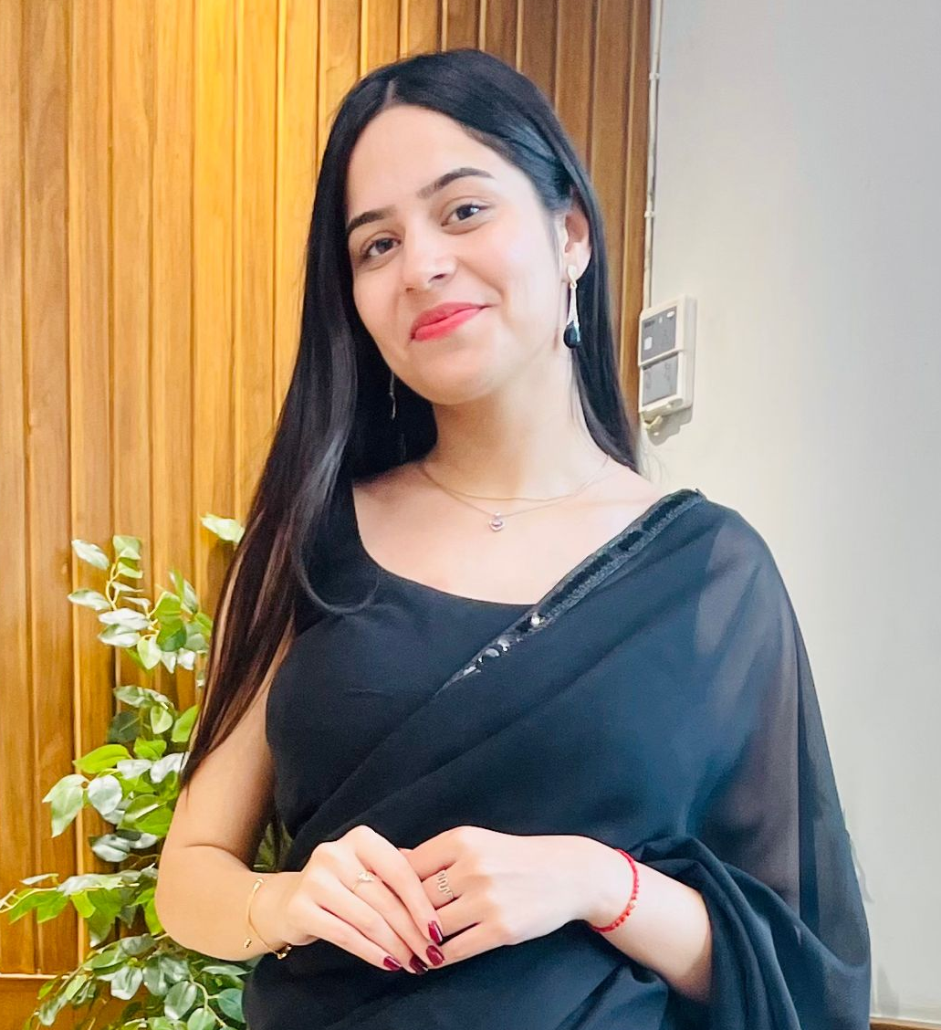
Toshika Sarvang
COUNCIL MEMBER WICCI – HPWC (Haryana Psychological Wellbeing Council)
BIO:
Ms. Toshika has done her graduation with a B.Sc. Psychology and her masters in Clinical Psychology. She is currently serving as an Assistant Professor at KCC Institute. She is a dedicated professional with a passion for education and psychology.

Slide 25
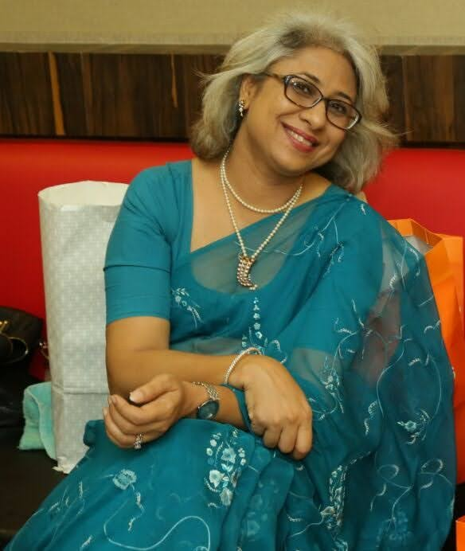
Yamini Goenka
COUNCIL MEMBER WICCI – HPWC (Haryana Psychological Wellbeing Council)
BIO:
Ms. Yamini is an RCI registered special educator and clinical psychologist, working in this field since last 17 years. She has worked for pushing inclusive education in Rajasthan and did achieve school level inclusion.
She can handle multiple disabilities since her specialization is in Cerebral palsy. Has done assessments to focus on their strength and weakness in all possible areas. These assessment facilitate in making an IEP for the child, home plan and intervention planning.
Apart from children with special needs, she has also counselled parents and children with exam phobias, anxiety depression, teenage issues, behaviour modification, epilepsy etc
She is a keen learner and completely dedicated for the cause.

Slide 26
SUPPORTED BY
WICCI is supported by the massive global networks of ALL Ladies League (ALL), Women Economic Forum (WEF), and SHEconomy.
ALL is a movement of ‘Sisters Beyond Borders.’
WEF is a platform for ‘Business Beyond Borders.’ SHEconomy is e-commerce for women worldwide in Goods & Services for ‘Commerce Beyond Borders’

Slide 27
COUNTRIES REPRESENTED
Albania, Angola, Armenia, Argentina, Australia, Azerbaijan, Bangladesh, Brazil, Burundi, Cameroon, Canada, Chad, China, Costa Rica, Croatia, Cyprus, Czech Republic, Colombia, Ecuador, Egypt, Ghana, Germany, Greece, Guatemala, Hong Kong, Hungary, India, Italy, Israel, Ireland, Japan, Kazakhstan, Kenya, Kyrgyzstan, Lesotho, Luxembourg, Malawi, Malaysia, Mexico, Moldova, Monaco, Montenegro, Morocco, Mozambique, Malta, Netherlands, Nigeria, Nepal, New Zealand, North Macedonia, Norway, Paraguay, Portugal, Peru, Puerto Rico, Philippines, Qatar, Romania, Russia, Rwanda, Serbia, Singapore, Slovenia, Spain, South Africa, South Korea, Suriname, Sweden, Switzerland, Syria, Tunisia, Turkey, Uganda, Ukraine, UK, Uruguay, Venezuela, Vietnam, Virgin Islands (US), UAE, USA, Uzbekistan, Zimbabwe.

Slide 28
WOMEN'S INDIAN CHAMBER OF COMMERCE ANDINDUSTRY

